Slide 1
Git Together
Keith Dahlby
@dahlbyk

Slide 2

Git Together
Keith Dahlby
@dahlbyk

Slide 3


Slide 4







Who am I?

Slide 5
Who are you?

Slide 6
Git Together
This talk is not about:
This talk is about:
Getting started
Local workflow
Search "Keith Git" on Vimeo
Internals
Lots of neat stuff…
Remotes
Team workflow

Slide 7
Vocabulary Quiz!

Slide 8


Slide 9
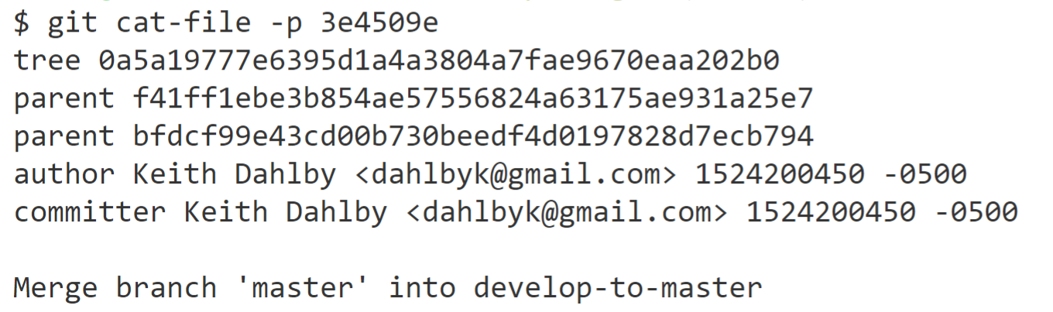

Slide 10

https://www.maxpixel.net/Cloud-Branch-Autumn-Brown-Barren-Branches-Closeup-2316715

Slide 11
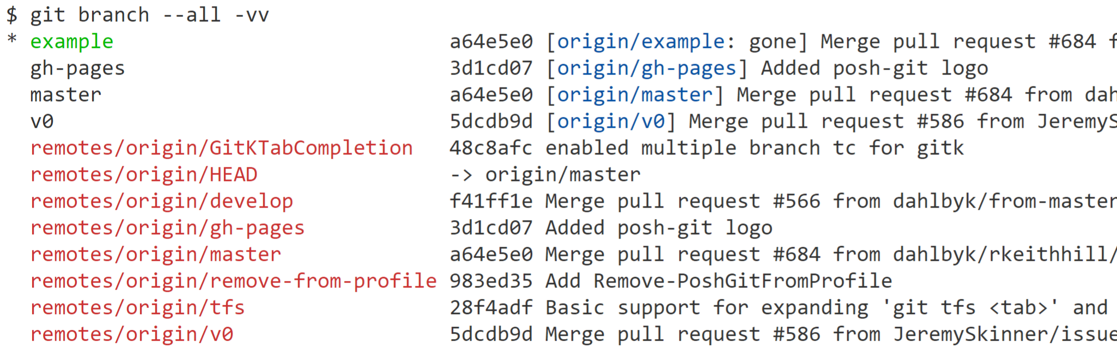

Slide 12

https://www.publicdomainpictures.net/en/view-image.php?image=60828&picture=colorful-gift-tags

Slide 13
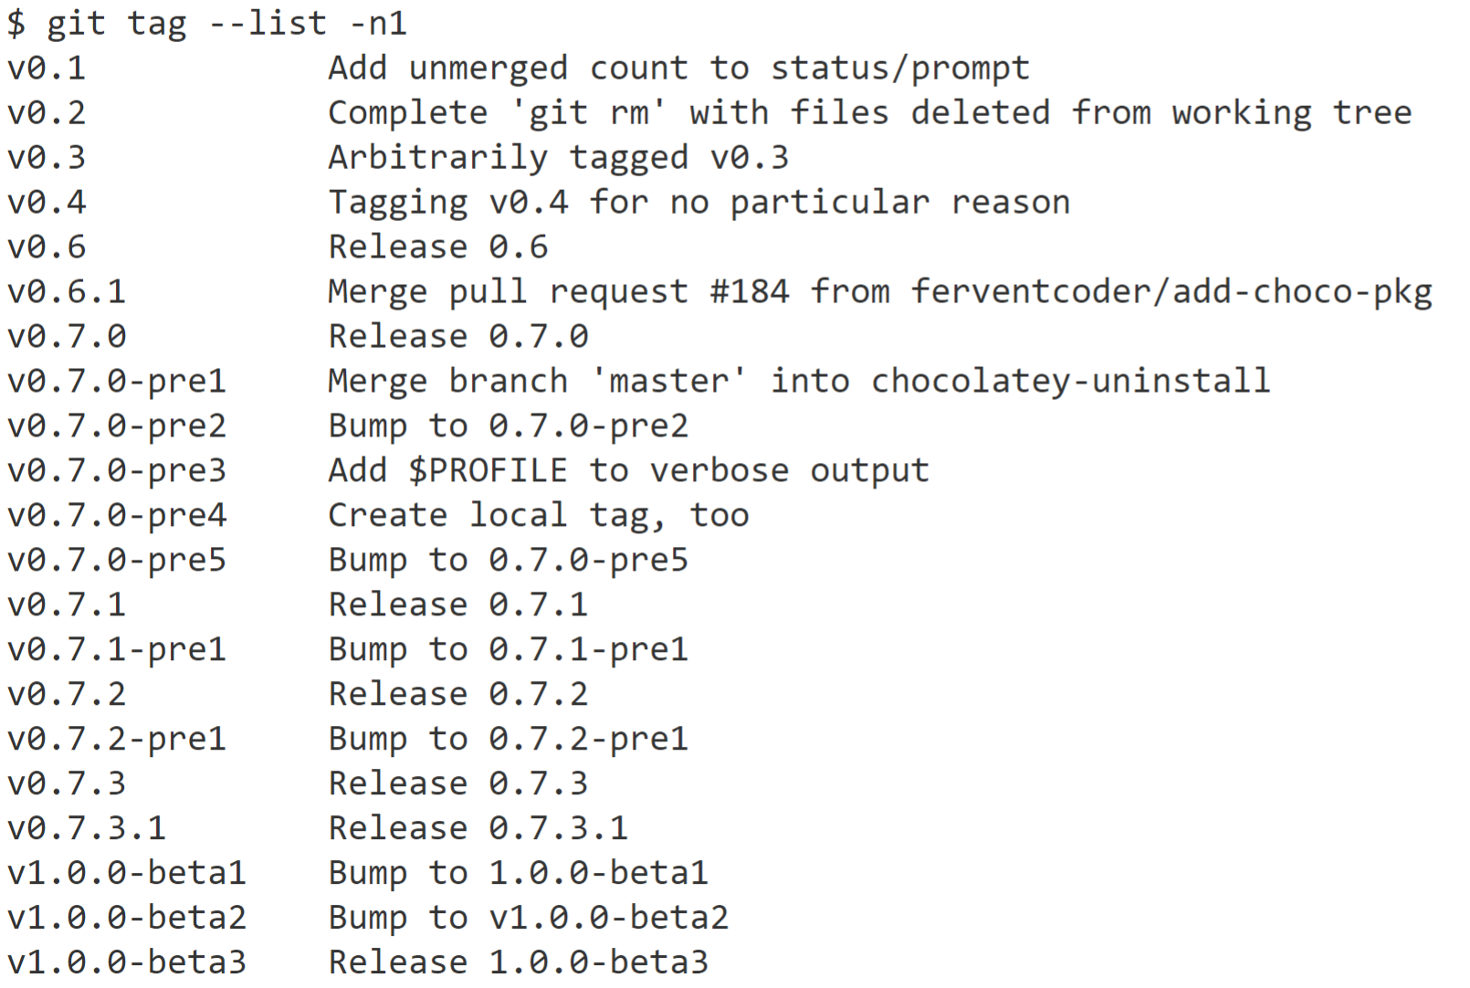

Slide 14
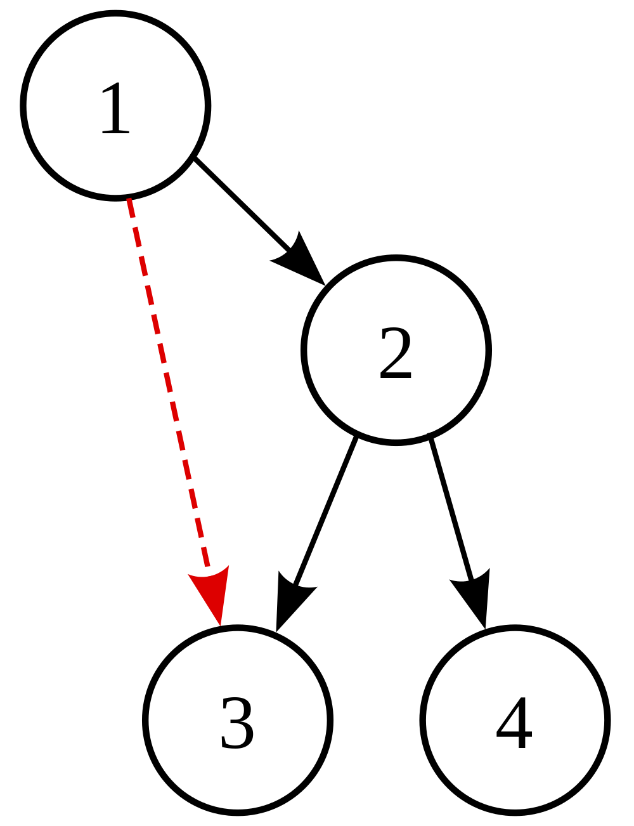
https://commons.wikimedia.org/wiki/File:Directed_graph_with_back_edge.svg

Slide 15
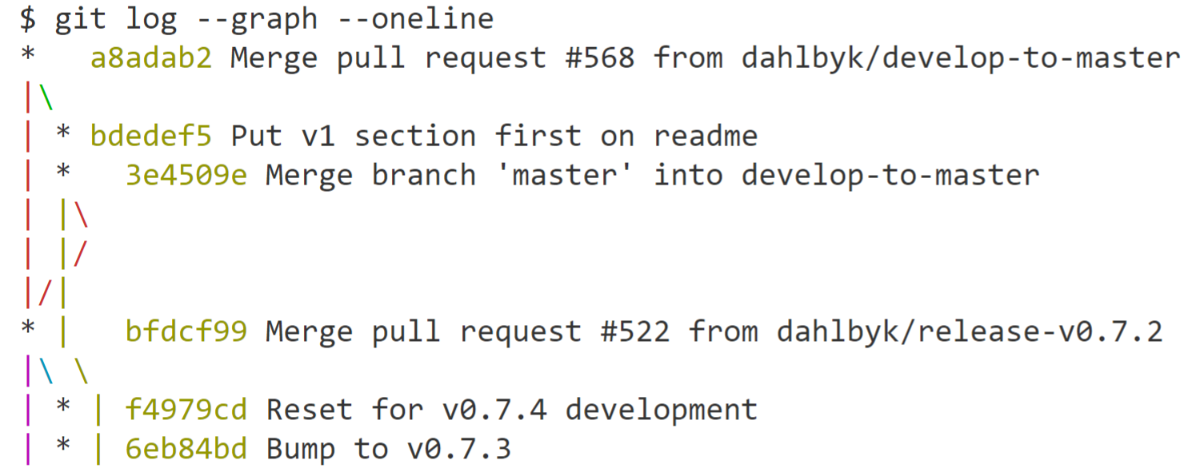

Slide 16

https://pixabay.com/illustrations/punishments-cartoon-character-idea-2933524/

Slide 17
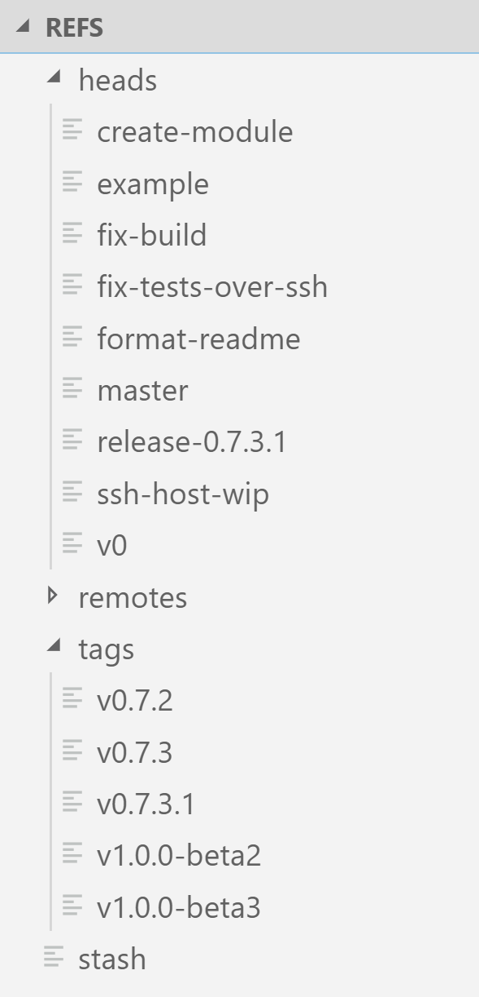

Slide 18

https://libreshot.com/remote-control/

Slide 19
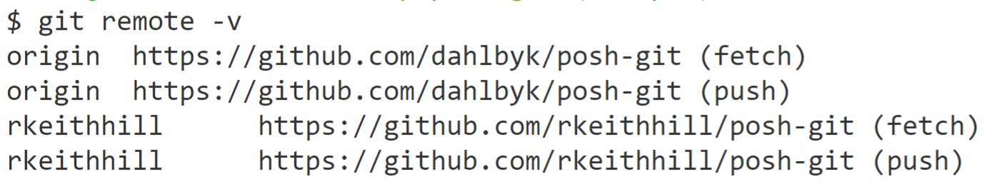

Slide 20

https://www.pexels.com/photo/stainless-steel-fork-on-white-background-39565/

Slide 21
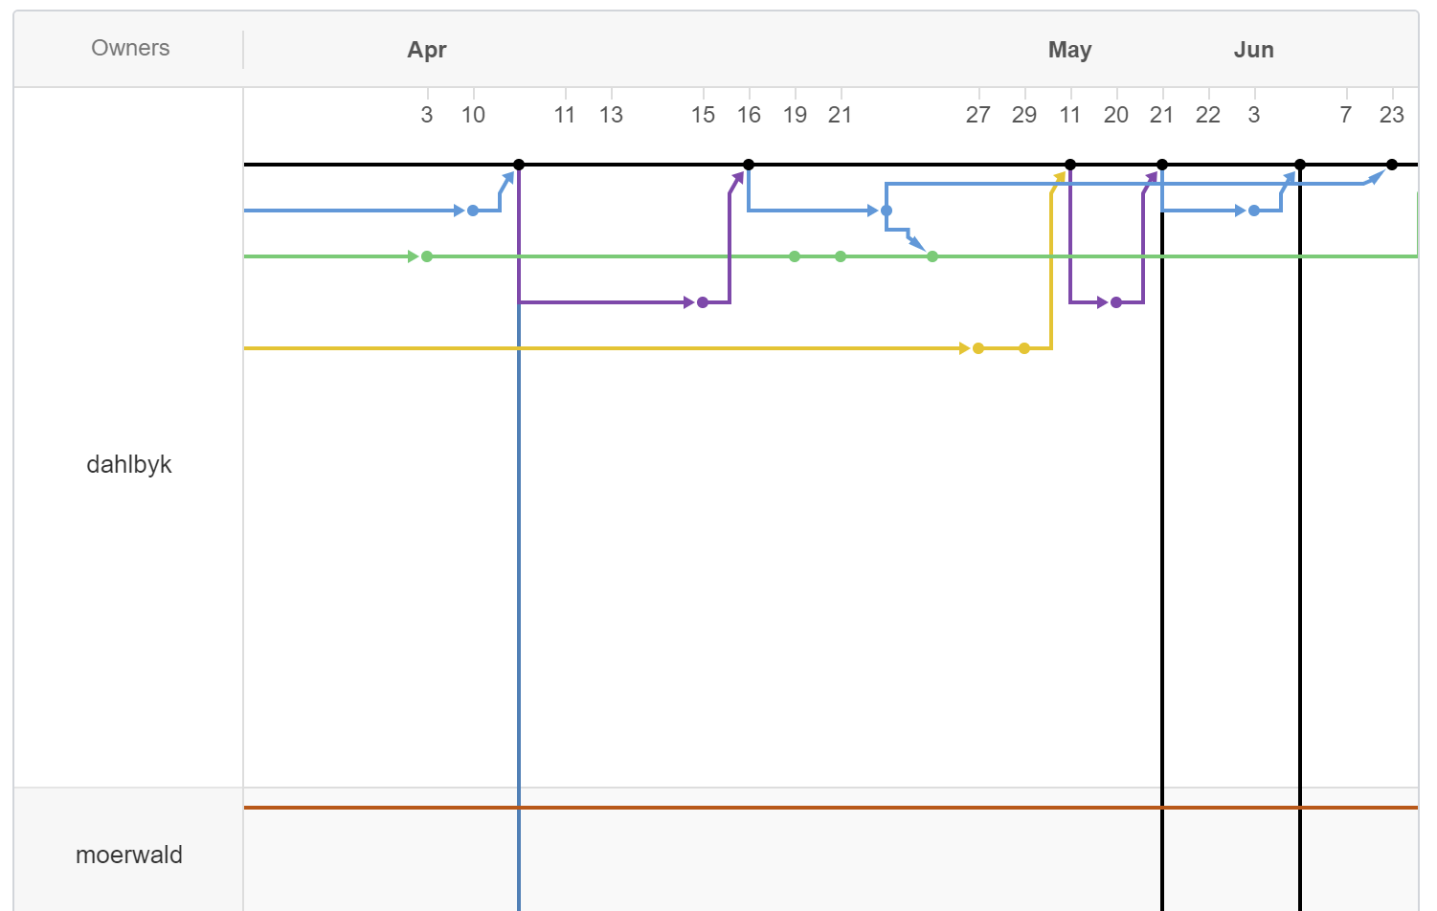
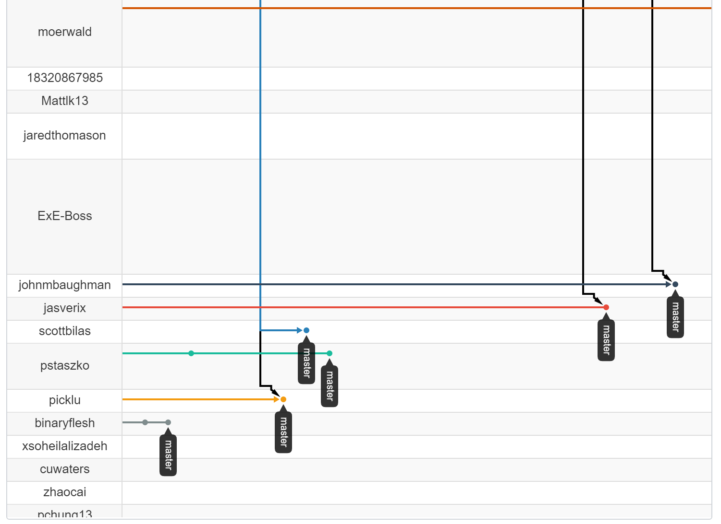

Slide 22
Remote Operations

Slide 23

https://giphy.com/gifs/80s-push-it-salt-n-pepa-lwki0upYCwQp2

Slide 24
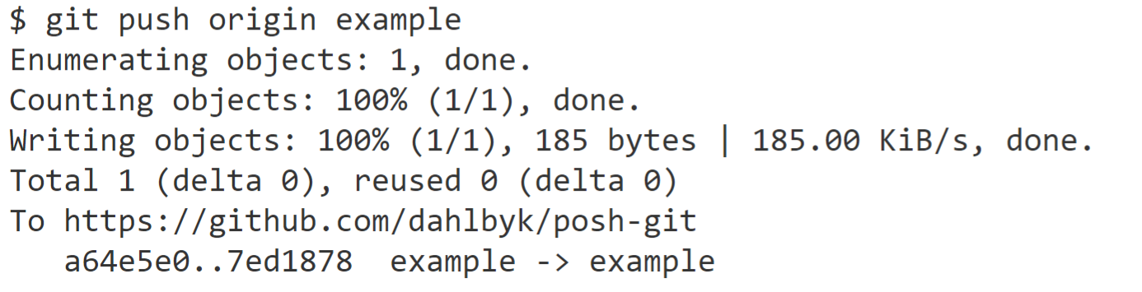

Slide 25

https://giphy.com/gifs/mean-girls-regina-george-stop-trying-to-make-fetch-happen-5G98t8QjqBLK8

Slide 26
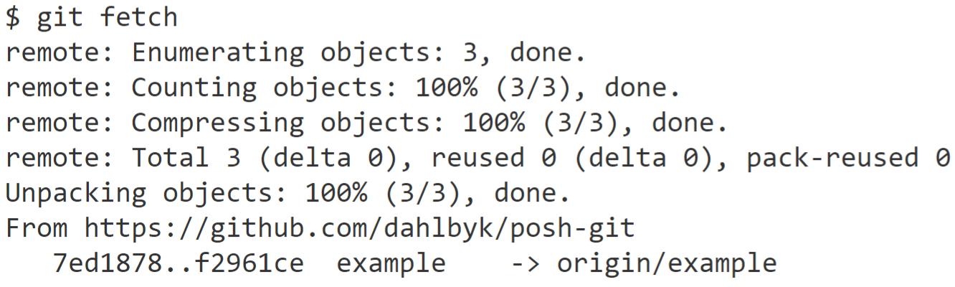

Slide 27

https://www.airforcemedicine.af.mil/News/Photos/igphoto/2000101890/

Slide 28
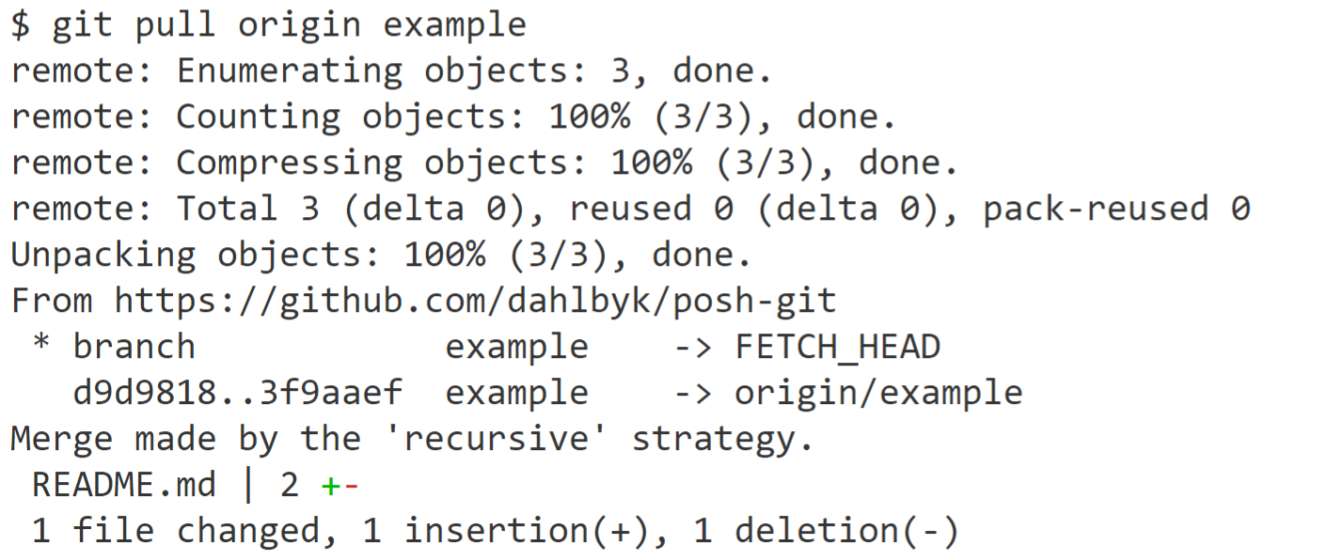

Slide 29
<Tangent topic="Config">

Slide 30
git config
git help config
git config -l
Scope | Switch | Location
Repository |  | .git/config
User | --global | ~/.gitconfig
System | --system | {install dir}/etc/gitconfig

Slide 31
git config
git config -e --global
# git config format.pretty "%C(auto)%h %d %s"
[format]
pretty = %C(auto)%h %d %s
# git config color.decorate.branch blue
[color "decorate"]
branch = blue

Slide 32
</Tangent>

Slide 33
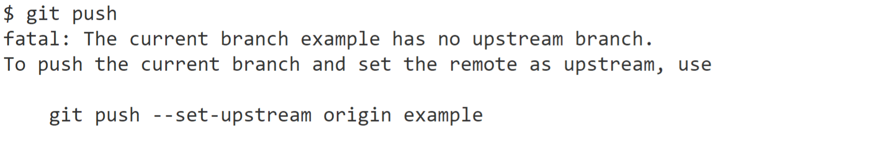
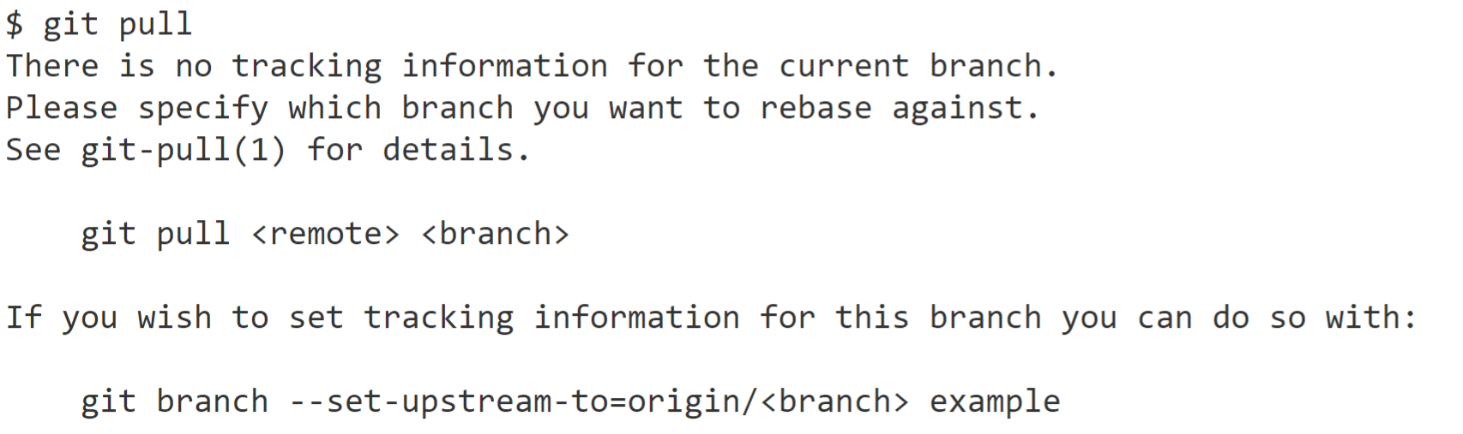
@dahlbyk #ThatConference

Slide 34
push.default
current
Push the current branch to update a branch with the same name on the receiving end.
upstream
Push the current branch back to the upstream/tracked branch (which is called @{upstream}).
simple
Like upstream for centralized remote
Like current when pushing to non-pull remote
Default since 2.0; safe – names must match

Slide 35
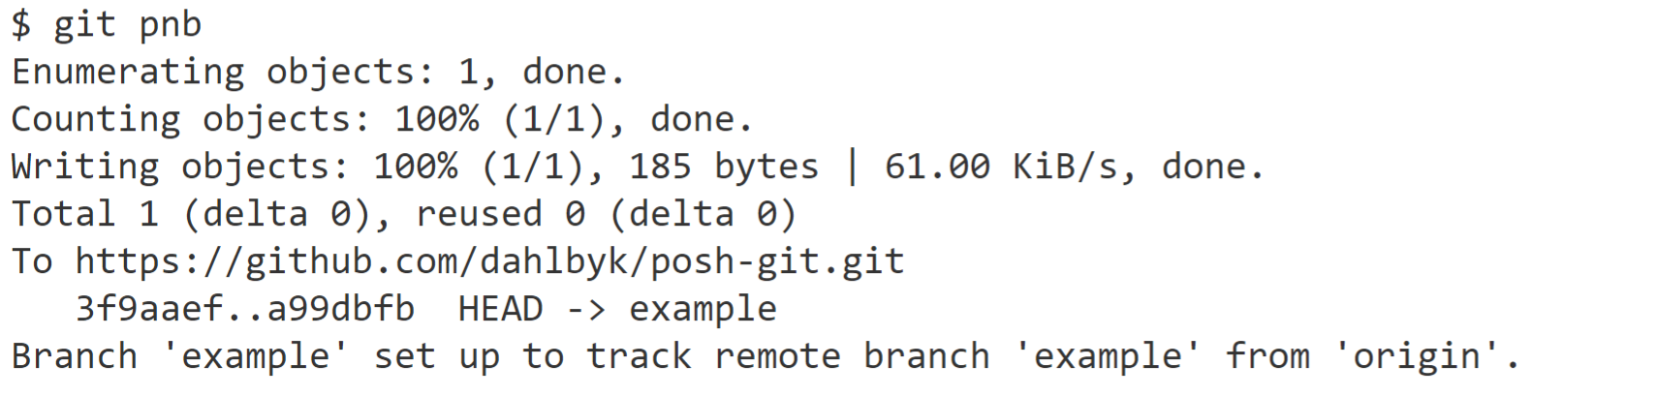
Push New Branch
git config --global alias.pnb "push -u origin HEAD"

Slide 36
Branch Configuration
[branch "example"]
remote = origin
merge = refs/heads/example
[branch "master"]
remote = upstream
pushRemote = origin # or set remote.pushDefault
merge = refs/heads/master

Slide 37
Fork Remote Configuration
[remote "origin"]
url = https://github.com/not-dahlbyk/posh-git.git
fetch = +refs/heads/*:refs/remotes/origin/*
[remote "upstream"]
url = https://github.com/dahlbyk/posh-git.git
fetch = +refs/heads/*:refs/remotes/upstream/*
fetch = +refs/pull/*/head:refs/remotes/upstream/pr/*
[remote]
pushDefault = origin

Slide 38
Team Workflow

Slide 39
Continous Integration on master?
Everyone works on master, pushing and pulling as needed
Technically this is the One True™ Continuous Integration (CI)
Loses nearly all advantages of Git and its ecosystem

Slide 40
Branching!
Ridiculously cheap – use liberally
Write SHA to file in refs/heads
Branches to clean up
git branch --merged
Clean up remote branches
git fetch --prune

Slide 41
My Workflow
Keep master clean!
New topic branch from master
git checkout master -b topic
“Switch to <commit> as new branch <name>”
Commit more than feels natural

Slide 42
GitHub Flow
Push New Branch (git pnb)
Open Pull Request or equivalent as early as possible
Use GitHub Draft, GitLab WIP, etc if not done
while (!done)
Additional changes, address feedback, etc
git push works now because of -u
Merge PR

Slide 43
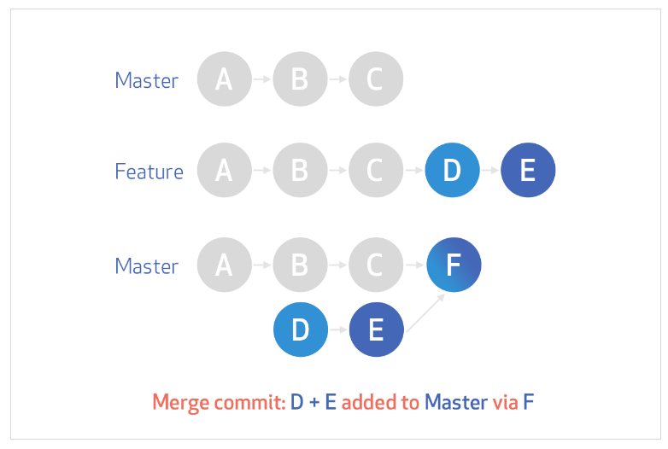
Merge Option 1: Merge Commit
https://help.github.com/en/articles/about-merge-methods-on-github

Slide 44
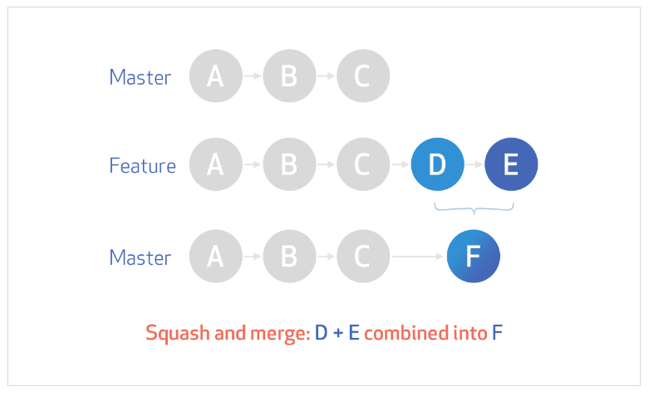
Merge Option 2: Squash & Merge
https://help.github.com/en/articles/about-merge-methods-on-github

Slide 45
Merge Option 3: Rebase & Merge
Work on feature branch
D---E feature
/
A---B---C master
feature is rebased onto master
D'--E' feature
/
A---B---C master
“Fast-forward” merge into master
A---B---C---D'--E' master, feature

Slide 46
merge vs rebase
Merge without rebase
D---E feature
/ \
A---B---C---M master
Merge after rebase
A---B---C---D'--E' master, feature
Deck of cards: shuffle vs cut

Slide 47
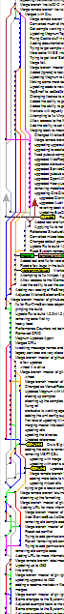
merge vs rebase

Slide 48
Merge Option 4: Rebase & Merge Commit
git checkout master && git pull
git rebase master feature
git push --force-with-lease
Review & create merge commit as usual
D---E topic
/ \
1-----------2-------3 master
\ /
A---B---C

Slide 49
git up
Rebase onto latest from origin & and update local master
git config --global alias.up
"!git fetch &&
git rebase origin &&
git push . origin:master"
origin by itself is origin/HEAD
git remote set-head origin -a

Slide 50
Force Push? Really?
Yes, really. Just be careful (lease)!
Branches are often just “changes since master”
Which master should rarely be relevant – conflicts!
Think today about the future you want to have tomorrow
Or a year from now…
Or a decade from now…

Slide 51
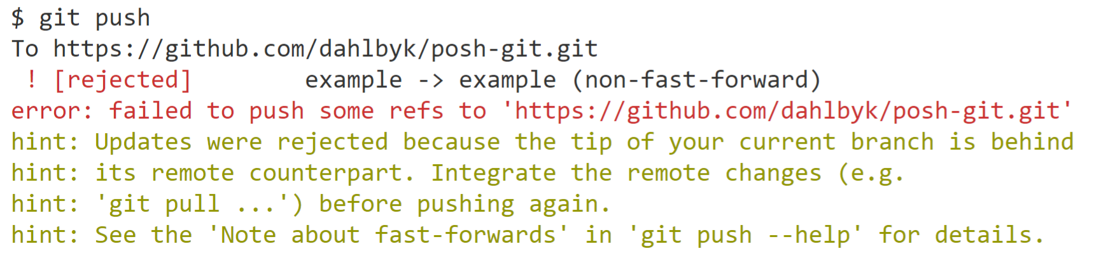
What about shared branches?
git checkout <feature>
If origin/feature exists, will create with tracking
Make changes…

Slide 52
git pull = fetch + ?
Two options:
fetch + merge
A---B origin/feature
\ \
C---M feature
fetch + rebase
A---B origin/feature
\
C' feature

Slide 53
git pull = fetch + ?
git pull --rebase
git pull --no-rebase
git pull --no-rebase --no-ff
git config --global pull.rebase true
I rarely use absolutes, but once you know rebase it is always better than pull with merge.

Slide 54

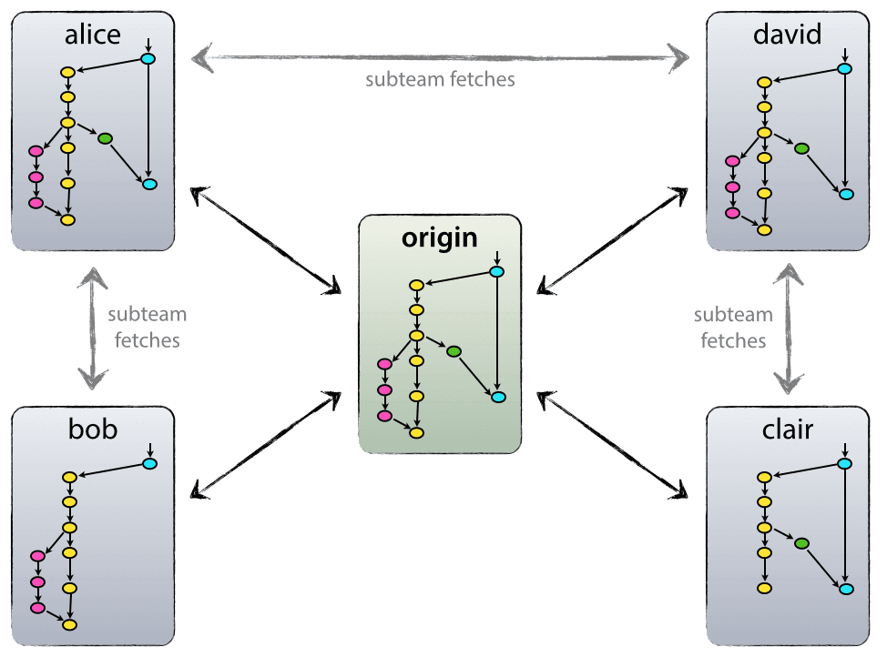
Git Flow
https://nvie.com/posts/a-successful-git-branching-model/

Slide 55

github.com/dahlbyk/Presentations

